Slide 1

ANDROID FORENSICS

Slide 2
Android Studio Installation
Download: Go to developer.android.com and download Android Studio.
Run Installer: Open the downloaded .exe file and follow the setup instructions.
Install SDK Components: Select necessary SDK tools and click "Next".
Set Environment Variables (Optional): Add ANDROID_HOME to system variables if needed.
Create a New Project: Open Android Studio and start a new project
21/02/25

Slide 3
ADB Minimal Installation
Download: Get "Minimal ADB and Fast boot" from a trusted source.
Run Setup: Open the installer and follow the instructions.
Verify Installation: Open Command Prompt and type adb version.
Enable USB Debugging: On your Android device, enable "Developer Options" → "USB Debugging".
Connect Device: Use a USB cable and type adb devices to check the connection

Slide 4
ADB Basic Commands
adb devices – Lists connected devices.
adb install <apk> – Installs an APK file.
adb push <local> <remote> – Transfers files to a device.
adb pull <remote> <local> – Copies files from a device.
adb reboot – Reboots the device
adb shell input text command
pm uninstall –k -user 0[package name]
exit

Slide 5
Sqlite Installation
Download SQLite from the official website.
Extract the archive and place SQLite in a system-accessible directory.
Add the SQLite directory to the system PATH variable.
Open a terminal and run sqlite3 to check installation.
Create and manage databases using SQLite commands.

Slide 6
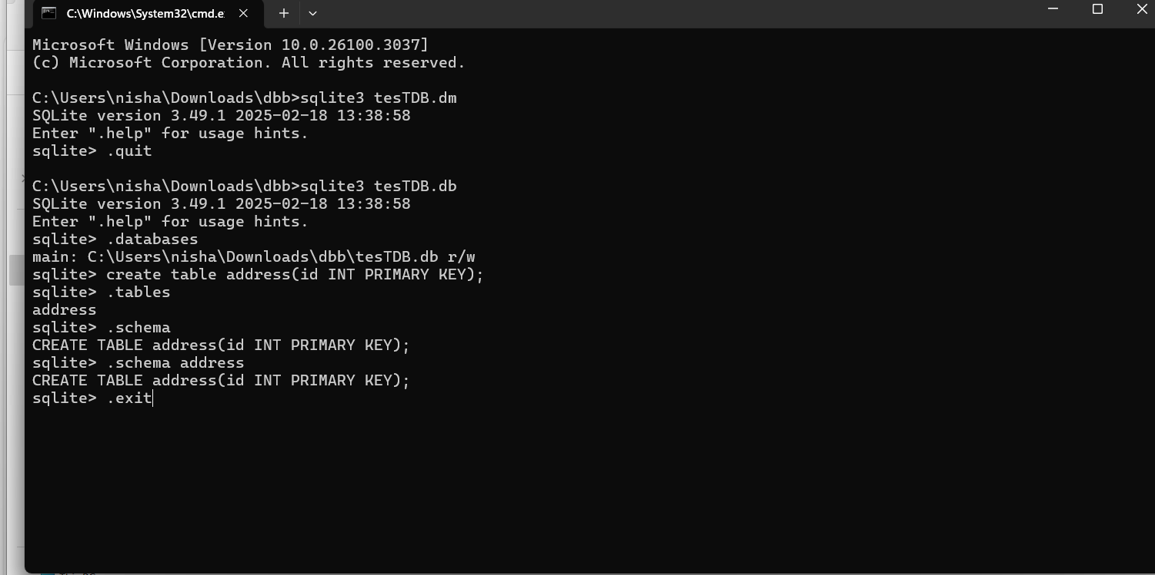
SQLite
Identifying SQLite database files
Extracting the database files
Analyzation using db. browser of SQLite, SQLite spy
Recovering deleted data
Reporting and documentation

Slide 7
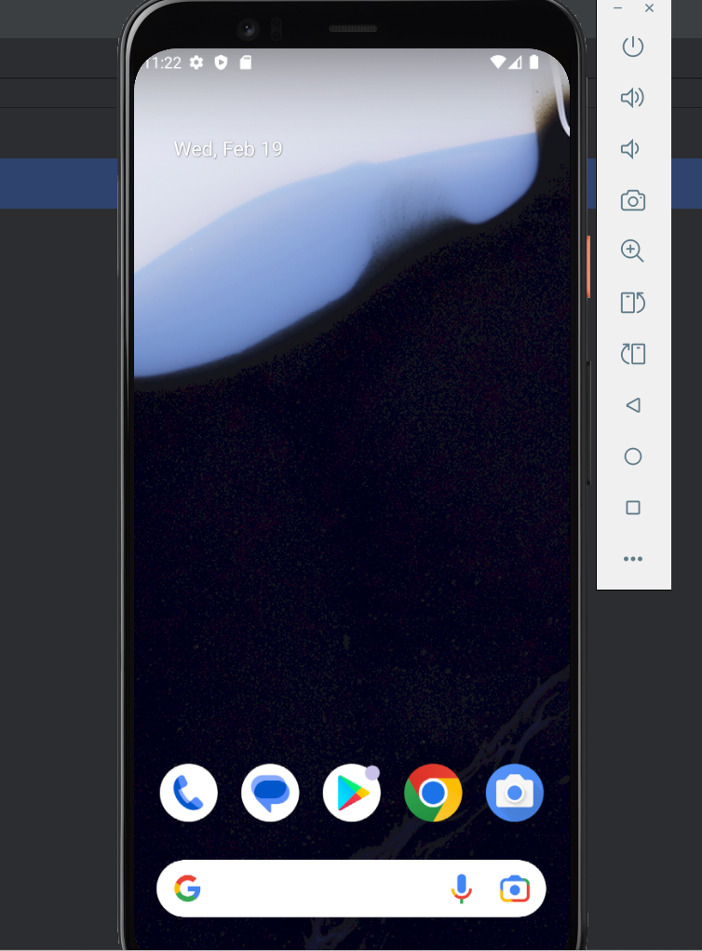
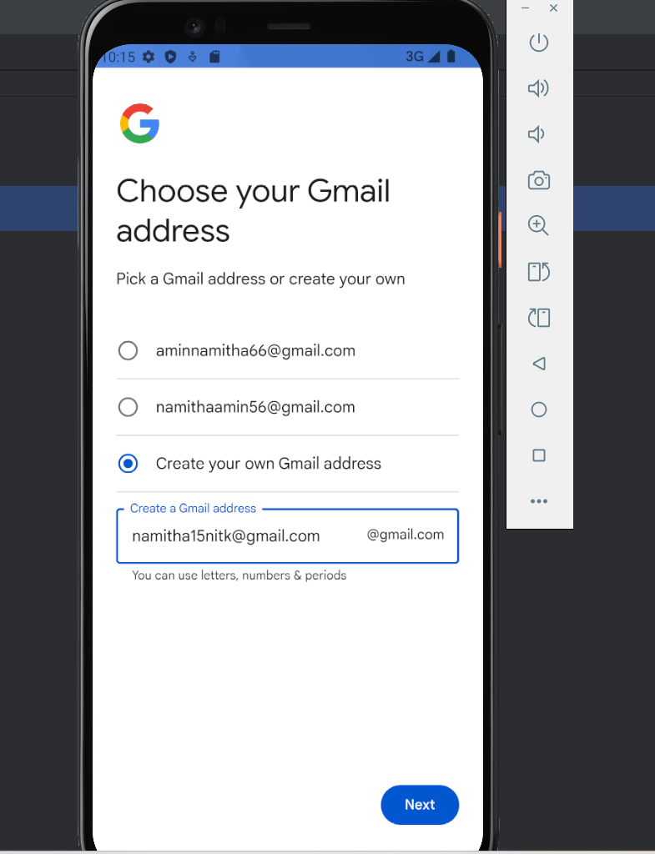
created virtual phone
signing to account
24/02/25

Slide 8
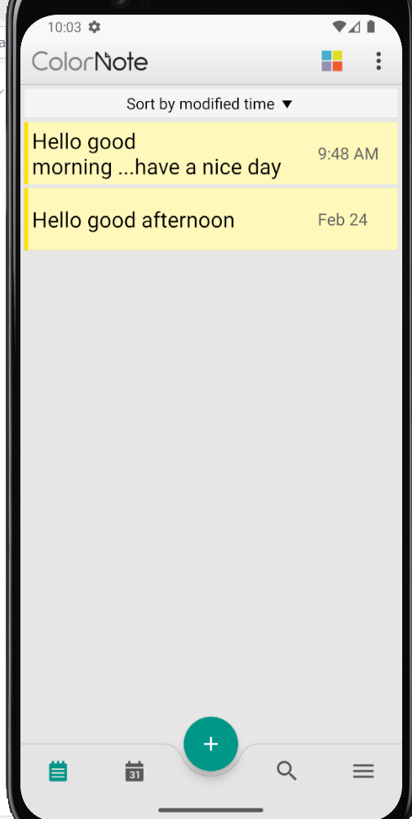
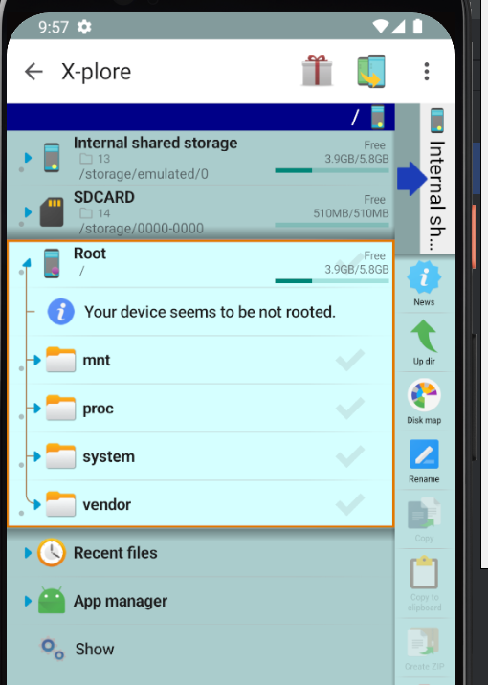
Download X-plore app and enable supermode button from configuration
Download Colornote app and create 2-3 files

Slide 9
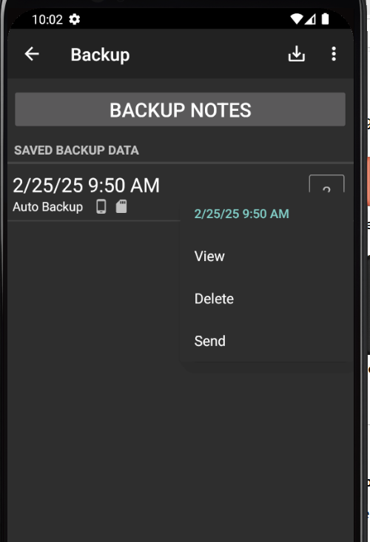
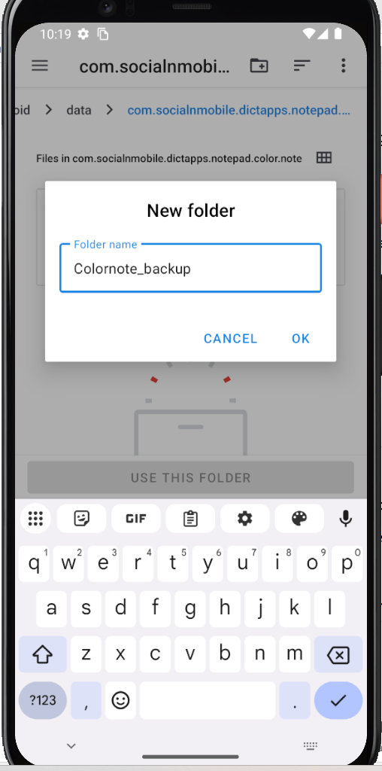
Enable backup option and backup the files
Creating folder

Slide 10
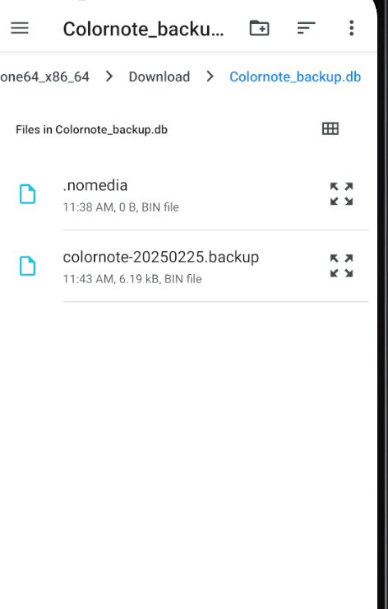
Created files are moved to folder

Slide 11
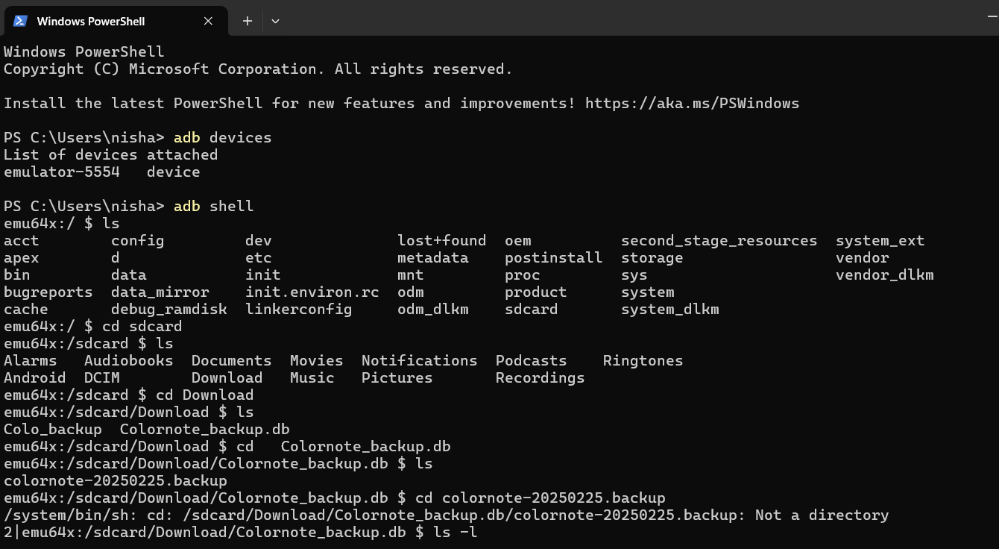

Slide 12
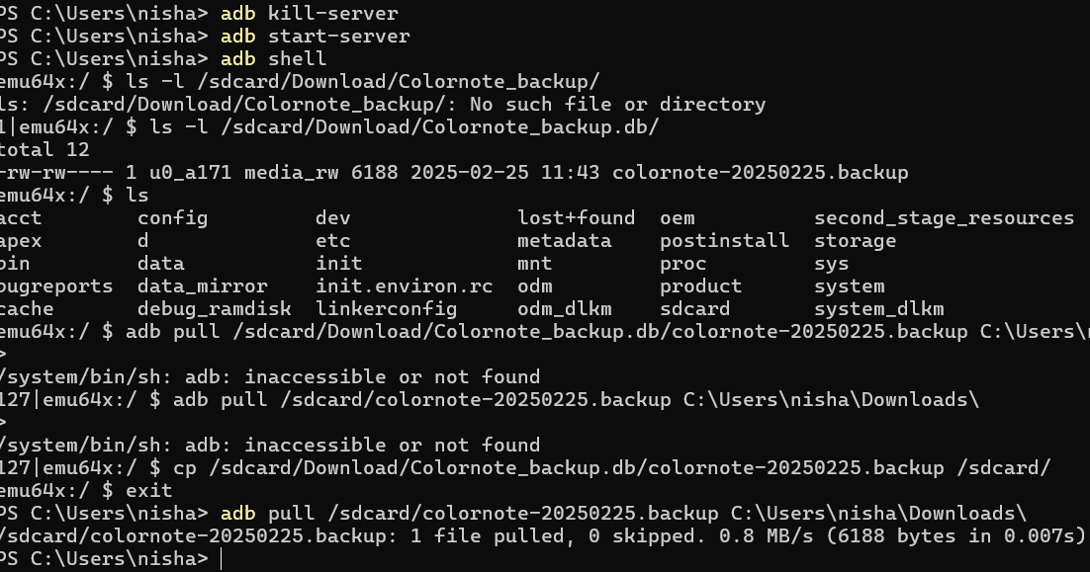

Slide 13
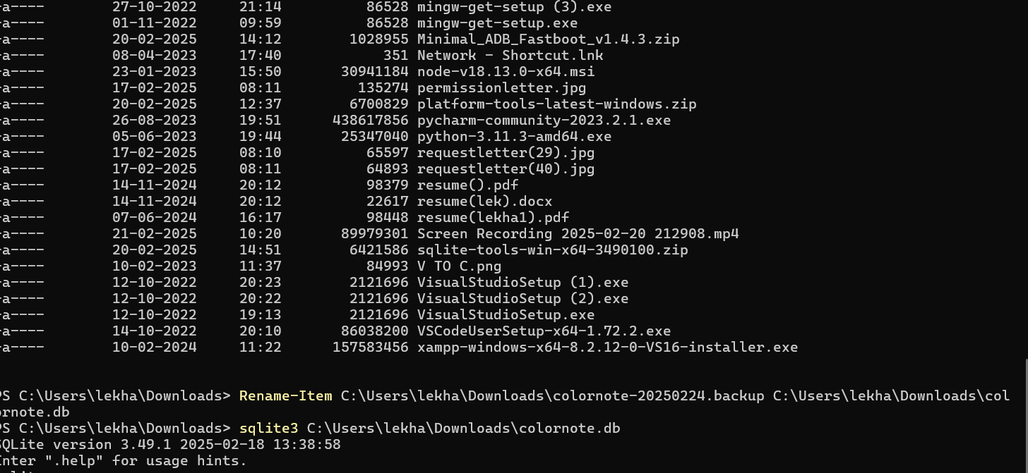

Slide 14
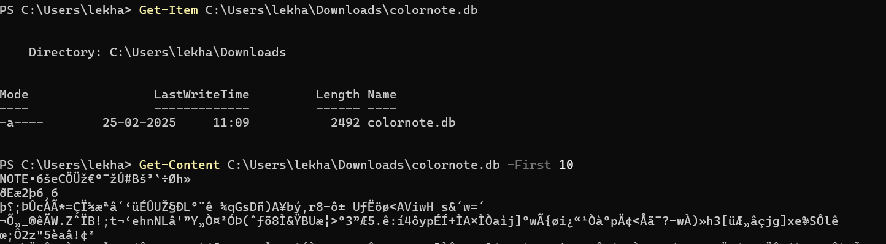
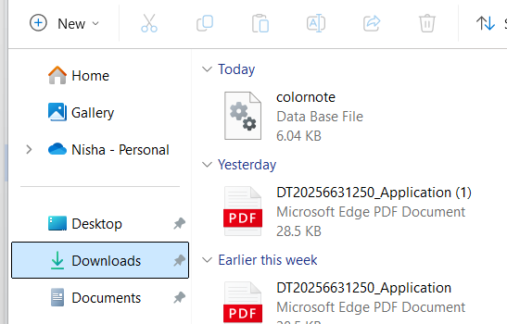

Slide 15
Introduction of ADB
ADB (Android Debug Bridge) is a command-line tool that allows communication between a computer and an Android device. It is widely used for debugging, file management, and system modifications. ADB is part of the Android SDK (Software Development Kit) and helps developers and users perform advanced operations on Android devices remotely via a USB connection or over a network.
26/02/25

Slide 16
Android File System Structure
Partion | Purpose | Access
/system | Stores the Android OS and system apps | Read-only (unless rooted)
/data | Stores installed apps and user data | Restricted (only accessible with root)
/cache | Temporary storage for app data and updates | Limited access
/sdcard or /storage/emulated/0 | User-accessible storage for files (photos, videos, documents) | Accessible without root
/vendor | Device-specific drivers and libraries | Read-only (unless rooted)
/boot | Stores kernel and bootloader files | Restricted access
/recovery | Holds recovery mode environment | Limited access
/proc | Virtual file system providing system information | Read-only
/dev | Contains device nodes and drivers | System-controlled

Slide 17
ADB Commands for File System Management
Checking Device Connection
>adb devices
Navigating the File System
Access shell:
>adb shell
List files in a directory:
>ls /sdcard/
Check storage details:
>df -h
Display detailed file permissions and attributes:
>ls -l /data/data/

Slide 18
Transferring Files
Copy a file from the device to the computer:
>adb pull /sdcard/file.txt C:\Users\YourPC\Desktop\
Copy a file from the computer to the device:
>adb push C:\Users\YourPC\Desktop\file.txt /sdcard/
Accessing System Files (Root Access Required)
Gain root access (if supported):
>adb root
Explore system files:
>adb shell su cd /data/data/ ls
Modify permissions for a specific file:
>chmod 777 /data/local/tmp/myfile

Slide 19
How ADB Helps in File Management
✅ Backup & Restore Data: Retrieve and restore app data efficiently.
✅ Recover Deleted Files: Possible if files are not overwritten.
✅ Debugging & Development: Analyse app logs and modify settings.
✅ Modify System Files: Requires root access for deeper modifications.
✅ Automate Tasks: Using scripts, you can automate file transfers and system modifications.
✅ Uninstall Bloatware: Remove pre-installed apps without rooting the device.
✅ Access Hidden System Information: View logs and system resource usage.
✅ Network Debugging: Control the device over Wi-Fi without USB.

Slide 20
File System Components
A file system consists of several key components:
a) Files
A file is a collection of related data stored on a disk.
Every file has a name, extension, and attributes
Examples: document.txt, image.jpg, database.db.
b) Directories (Folders)
A directory is a container for files and other directories. Documents/
It helps in organizing files in a hierarchical structure.
├── Notes/
│ ├── notes.txt
│ ├── tasks.docx
│
├── Projects/
│ ├── project1/
│ ├── project2/
27/02/24

Slide 21
c) Metadata
Information about files, such as:
File name
Size
Creation date
Permissions (read, write, execute)
Owner details
Blocks & Clusters
Files are stored in fixed-size blocks or clusters on the disk.
The file system manages the mapping of file data to these blocks.

Slide 22
File System Structure
Defines how files are stored and retrieved.
Most modern file systems use a hierarchical directory structure (tree-like).
C:\Users\John\Documents\notes.txt
Journaling (in some file systems)
Used in advanced file systems like NTFS and ext4.
Helps prevent data loss by keeping track of changes before they are committed.

Slide 23
File System Types
Different operating systems use different file systems:
a) Windows File Systems
FAT32 (File Allocation Table 32)
Older system, used in USB drives and SD cards.
Supports files up to 4GB in size.
Maximum partition size: 2TB.
No built-in security features.
NTFS (New Technology File System)
Default file system for Windows.
Supports file encryption, permissions, compression, and journaling.
Maximum file size: 16TB.
exFAT (Extended File Allocation Table)
Designed for flash drives and external drives.
No file size limits.
Compatible with Windows, macOS, and Linux.

Slide 24
b) Linux/Unix File Systems
ext3 (Third Extended File System)
Older system but reliable.
Supports journaling to prevent data corruption.
ext4 (Fourth Extended File System)
Default Linux file system.
Supports files up to 16TB.
Faster and more efficient than ext3.
XFS
High-performance file system for large data sets.
Good for enterprise environments.

Slide 25
File System Organization
a. Single-Level Directory
All files are stored in a single directory.
Simple but impractical for large systems.
b. Two-Level Directory
Separate directories for each user.
Prevents file name conflicts.
c. Hierarchical Directory Structure
Tree-like organization (e.g., Windows C:\Users\Documents).
Allows efficient file management.
d. Graph Directory Structure
Allows files to have multiple parent directories (symbolic links).

Slide 26
File Allocation Methods a. Contiguous Allocation
Stores file blocks next to each other.
Fast but can lead to fragmentation.
b. Linked Allocation
Each file is a linked list of disk blocks.
Eliminates fragmentation but slower.
c. Indexed Allocation
Uses an index table to track file blocks.
Faster access and efficient.

Slide 27
FAT32 File System
FAT32 (File Allocation Table 32) is an improved version of the older FAT16 file system, commonly used in USB drives, memory cards, and older Windows systems. It organizes data efficiently but has limitations, such as a maximum file size of 4GB
How Files Are Allocated in FAT32
The File Allocation Table (FAT) is a core part of the FAT32 file system. It is a map that keeps track of where data is stored on the disk. The FAT is stored at the beginning of the storage device and helps the operating system locate files quickly.
Steps of File Allocation in FAT32:
Disk is Divided into Clusters
The disk is divided into sectors (smallest physical storage unit).
Multiple sectors form a cluster (smallest logical unit used for file storage).
FAT32 uses 32-bit addresses to identify clusters, allowing larger storage than FAT16.

Slide 28
2. File is Broken into Clusters
When a file is saved, it is split into multiple clusters.
Each cluster is assigned an entry in the File Allocation Table (FAT).
3. FAT Tracks Cluster Chain
The FAT contains an entry for each cluster, pointing to the next cluster of the file.
If a file is too large for one cluster, it is spread across multiple clusters (linked list structure).
4. End of File (EOF) Marker
The last cluster of the file is marked with an EOF (End of File) identifier.
This tells the system that there are no more clusters for this file

Slide 29
Example of File Storage in FAT32
Let's assume we have a 500 KB file, and each cluster is 4 KB in size.
Total clusters required = 500 KB / 4 KB = 125 clusters
The first cluster is allocated and recorded in the FAT.
The FAT entry for the first cluster points to the second cluster.
This continues until the last cluster, which is marked with EOF.
Cluster # | Next Cluster #
100 | 101
101 | 102
…… | …..
124 | 125
125 | EOF

Slide 30
File System Structure of FAT32
Main Components:
Boot Sector
Contains essential information about the disk (e.g., file system type, cluster size, total sectors).
First sector of the storage device.
File Allocation Table (FAT)
Stores entries that map clusters to files.
Typically, two copies of FAT exist for redundancy.
Root Directory
Stores metadata about files and directories (e.g., name, size, timestamps).
Data Region
Stores the actual file contents.

Slide 31
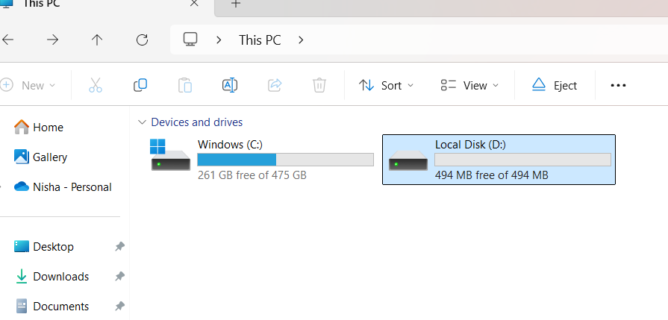
In Command Prompt as Administrator:
diskpart create vdisk file=C:\virtualusb.vhd maximum=500 type=fixed select vdisk file=C:\virtualusb.vhd attach vdisk create partition primary format fs=fat32 quick assign exit

Slide 32
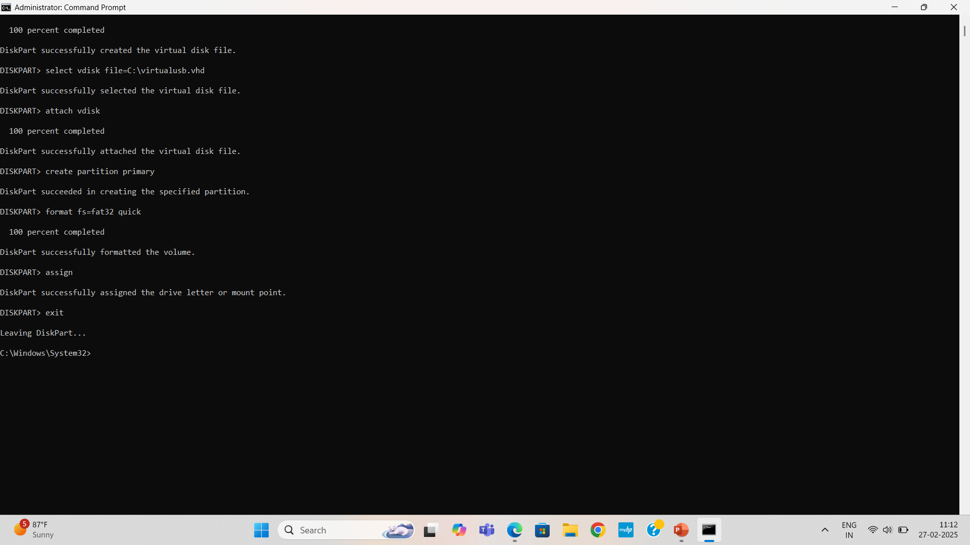

Slide 33
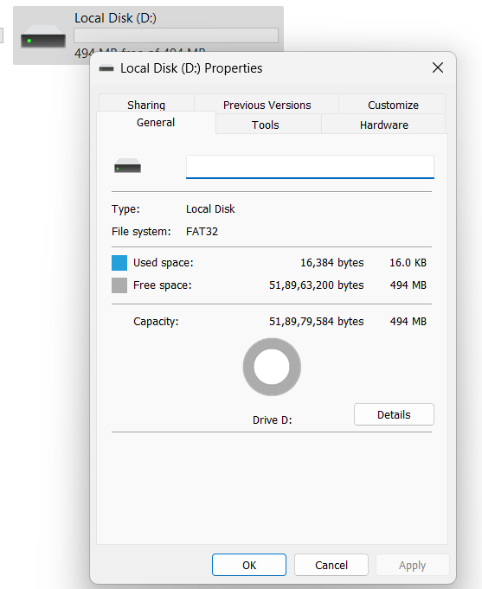
$file = "C:\Users\YourUsername\Desktop\my4GBfile.bin"
$size = 4GB
$fs = [System.IO.File]::Create($file)
$fs.SetLength($size)
$fs.Close()

Slide 34
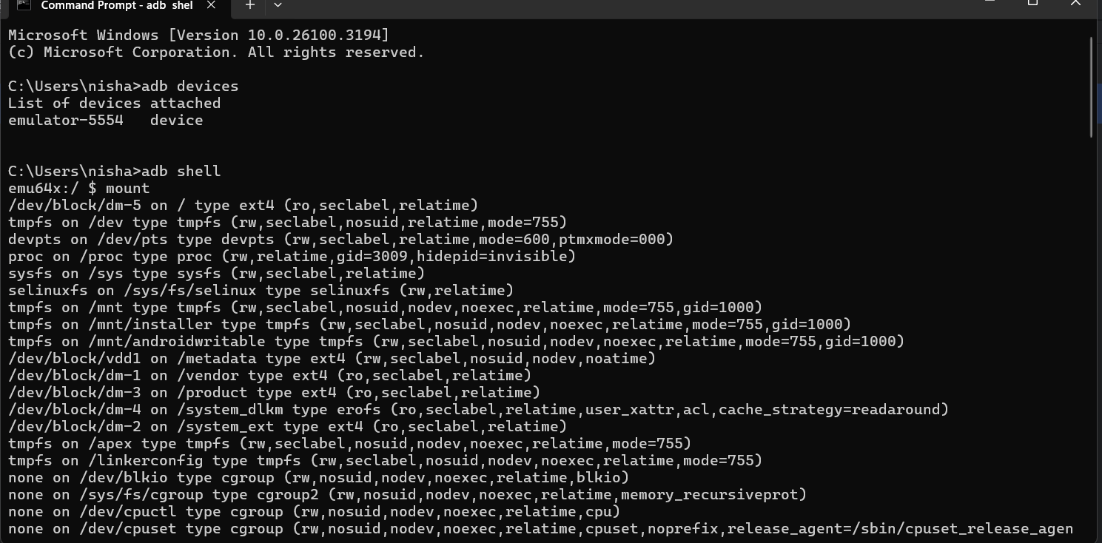

Slide 35
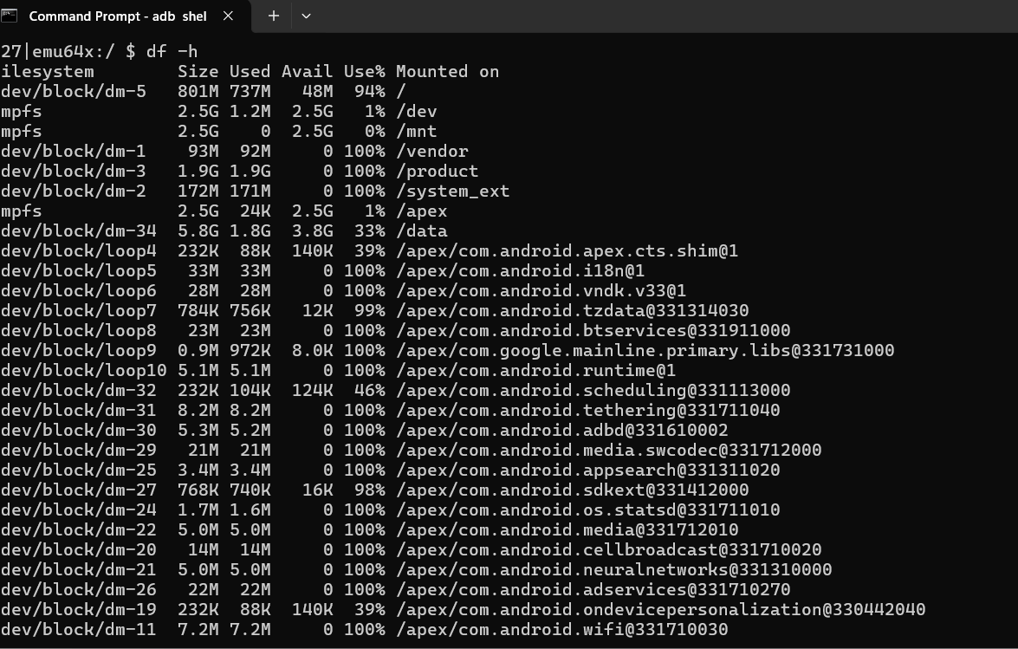

Slide 36
Partitions in Android
Android storage is divided into multiple partitions, including:
/boot – Stores the bootloader and kernel.
/system – Contains the core Android operating system (OS).
/vendor – Needed for the Android OS to communicate with hardware.
/recovery – Stores recovery mode tools (used for factory resets and flashing updates).
/cache – Holds frequently accessed temporary files.
/data (/userdata) – Stores user-installed apps, app data, and user settings.
/sdcard (/storage/emulated/0) – User-accessible storage for media files, downloads, etc.

Slide 37
How These Partitions Work Together
When you power on your phone, the /boot partition starts the system.
The kernel loads from /boot and begins using the /system partition.
The /vendor partition ensures hardware compatibility.
Apps and settings are retrieved from the /data partition.
If a problem occurs, you can use the /recovery partition for troubleshooting.

Slide 38
File System Types Used in Android
Storage Type | File System Used | Purpose
Internal Storage | ext4, F2FS | Stores system files, app data, and settings.
SD Cards (Older) | FAT32, exFAT | Used for media files (photos, videos, music).
SD Cards (Newer) | exFAT, NTFS | Supports large files (4GB+).
Virtual Storage | Emulated (FUSE) | Provides a unified view of storage to apps.

Slide 39
Internal Storage (ext4, F2FS)
Purpose: Stores the Android OS, system files, installed apps, and app data.
How It Works:
Internal storage is the main storage of your phone.
It holds everything needed to boot and run Android, including pre-installed apps, user-installed apps, and their data.
It is not directly accessible to users without root permissions.
File System Used:
ext4 (Extended File System 4)
Default in most Android devices.
Uses journaling (prevents data corruption if the phone crashes).
Efficient for general use cases.
F2FS (Flash-Friendly File System)
Designed specifically for flash storage (SSDs, eMMC, UFS in phones).
Faster than ext4 for handling small file writes (e.g., app cache, logs).
Some Android devices use F2FS for better speed and battery efficiency.

Slide 40
SD Cards (Older) - FAT32, exFAT
Purpose: Used for external storage like SD cards for photos, videos, music, and documents.
How It Works:
Android supports SD cards, which allow users to expand their storage.
Older SD cards use FAT32 or exFAT, which are widely compatible with other devices (PCs, cameras, etc.).
Apps cannot install directly on FAT32 SD cards (without formatting as internal storage).
File System Used:
FAT32
Maximum file size: 4GB (cannot store files larger than this).
Maximum partition size: 2TB (most OS supports up to this).
Used in older Android versions and low-end SD cards.
exFAT (Extended File Allocation Table)
No 4GB file size limit (can store large videos).
Works better for modern SD cards (microSDXC, 64GB+ cards).
Supported in Android 4.4+.
Example:
A 4K video file (5GB) cannot be saved on a FAT32 SD card but works fine on an exFAT SD card.

Slide 41
SD Cards (Newer) - exFAT, NTFS
Purpose: Supports larger files and higher speeds for modern storage devices.
How It Works:
Some Android phones support NTFS (Windows file system), allowing fast read/write speeds.
Newer SD cards (128GB, 256GB+) mostly use exFAT or NTFS instead of FAT32.
NTFS allows file encryption and compression, but is not natively supported on all Android devices (requires third-party apps like Paragon NTFS).
File System Used:
exFAT
Supports huge files (no 4GB limit).
Compatible with Windows, macOS, and Android.
NTFS (New Technology File System)
Faster than FAT32 and exFAT.
Supports file permissions and encryption.
Not always supported by default on Android.
Example:
If you transfer a 10GB movie to your phone's SD card, it will fail on FAT32 but work on exFAT/NTFS.

Slide 42
Virtual Storage (Emulated - FUSE)
Purpose: Provides a user-friendly way to manage storage, even when there is no real SD card in the device.
How It Works:
Many modern Android phones do not have a real SD card slot, but still show "/storage/emulated/0/" as "Internal Storage".
Android uses FUSE (Filesystem in Userspace) to emulate an SD card in internal storage.
This allows apps to store files in "external storage" even if no SD card exists.
Apps request access to /storage/emulated/0/, but it's actually part of internal storage.
Example:
If you take a photo, it is stored in /storage/emulated/0/DCIM/Camera/ (not a real SD card but a virtual one).

Slide 43
Deleted files Recovery
Android File System & Deletion Behavior
Internal Storage (ext4, F2FS)
Files deleted from /data/data/ cannot be recovered easily without root.
If the system overwrites the deleted space, recovery becomes impossible.
SD Cards (FAT32, exFAT)
Easier to recover deleted files from SD cards using tools like PhotoRec or Recuva.
FAT/exFAT does not "securely delete" files, leaving data intact.
Virtual Storage
Android emulates storage meaning /storage/emulated/0/ is just a logical partition inside internal storage.
03/03/25

Slide 44
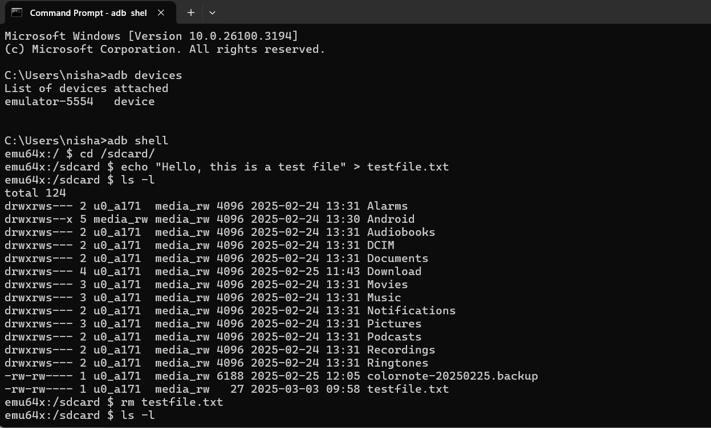
SD Cards

Slide 45
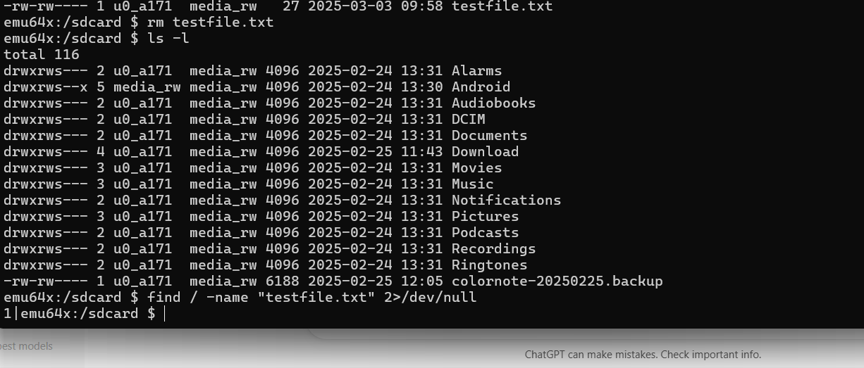

Slide 46
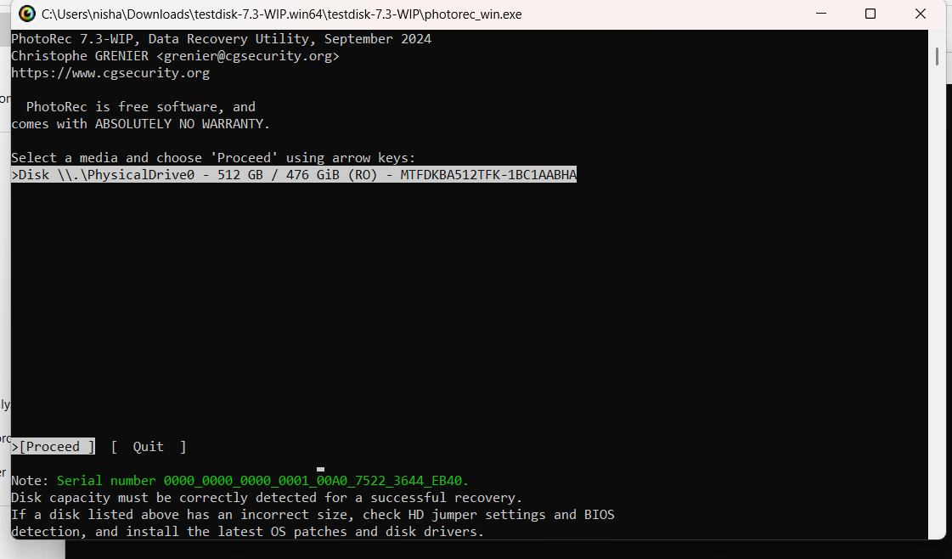

Slide 47
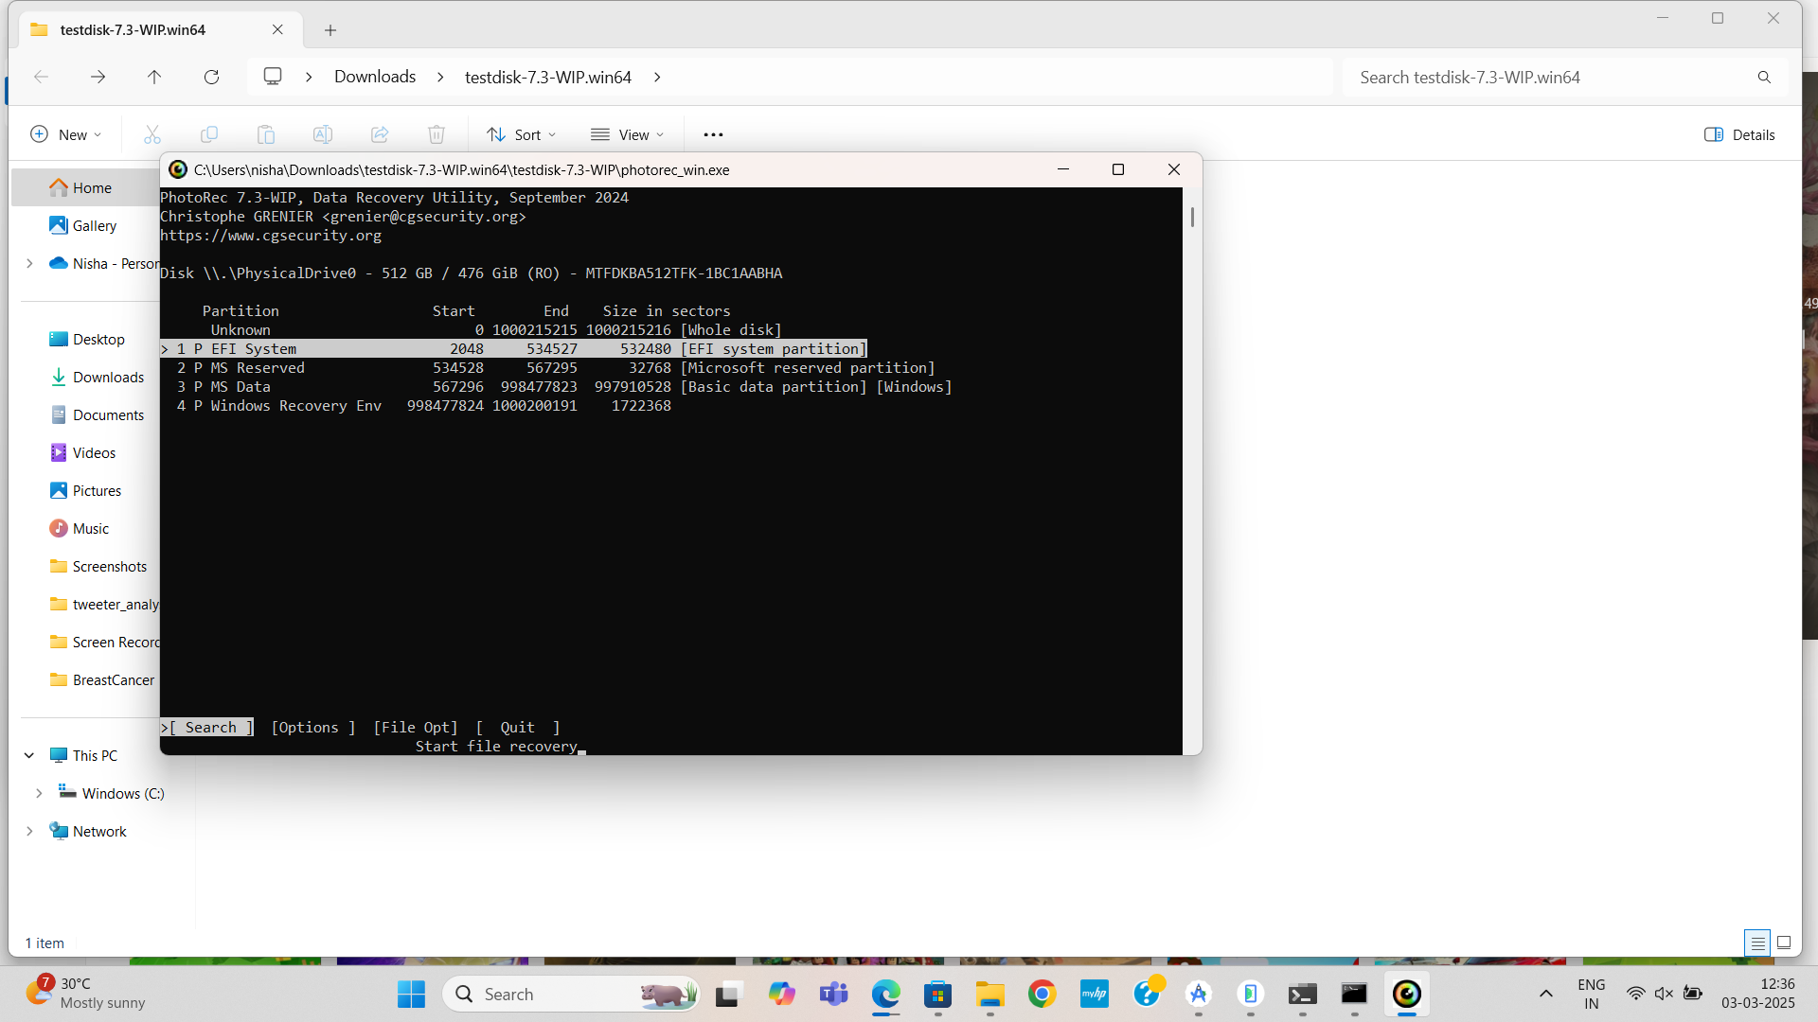

Slide 48
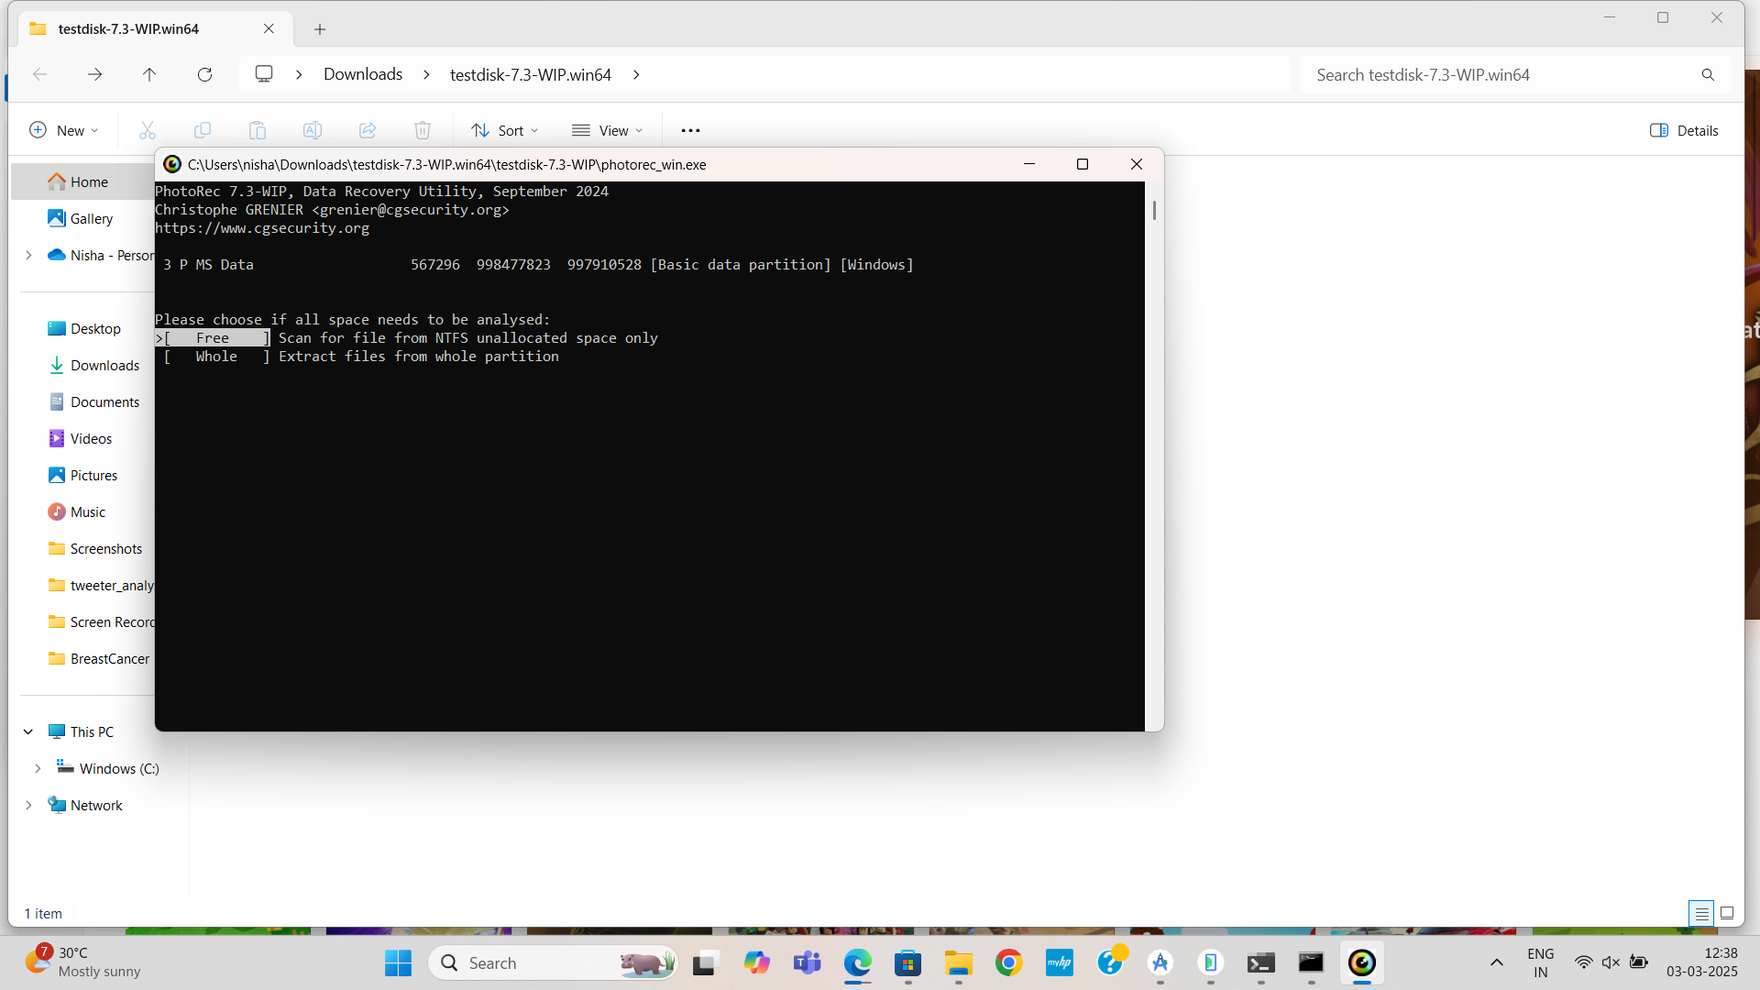

Slide 49
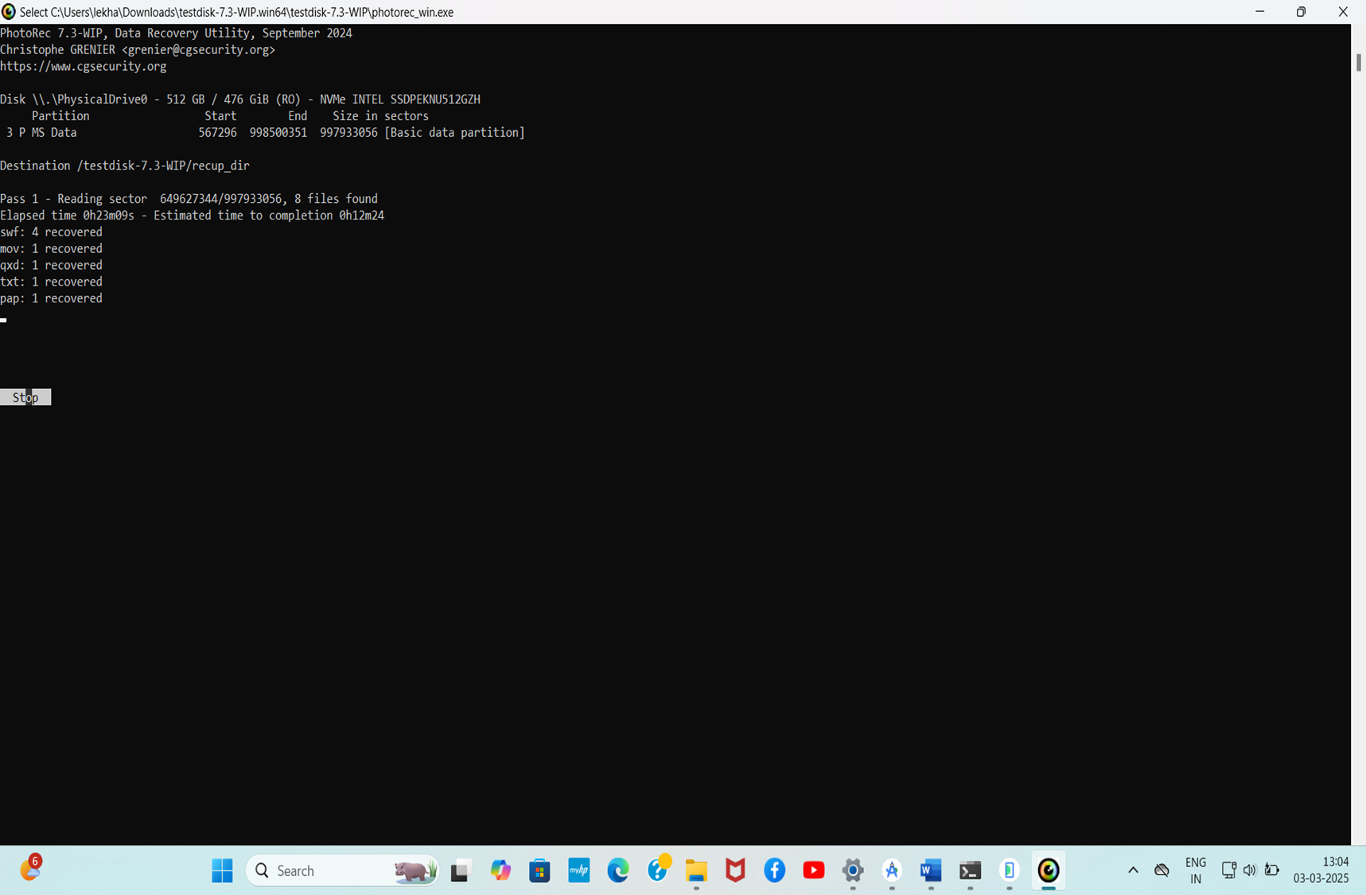

Slide 50
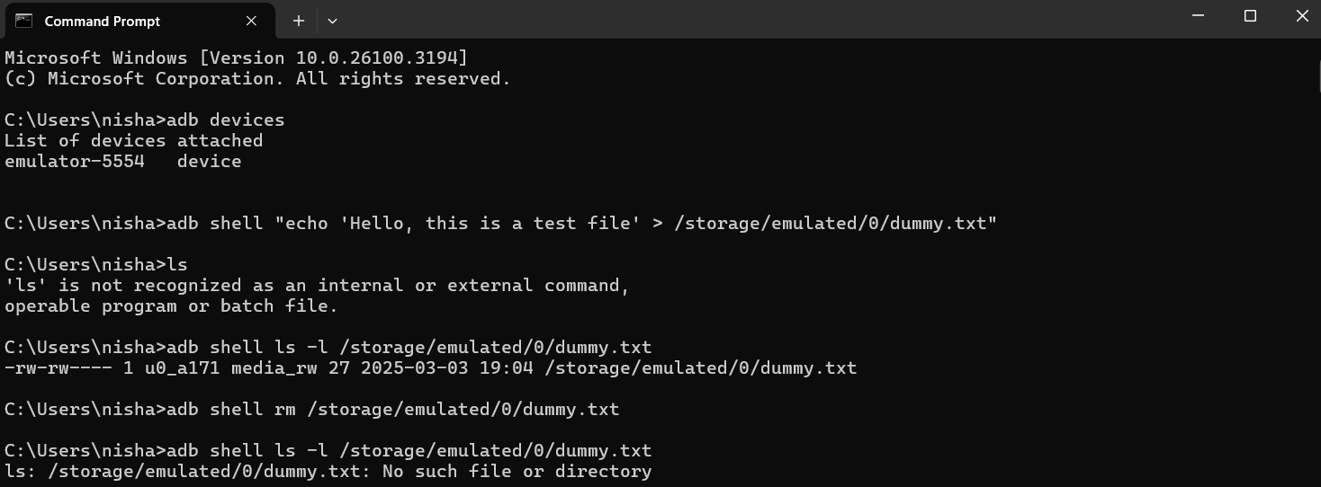
Virtual Storage

Slide 51
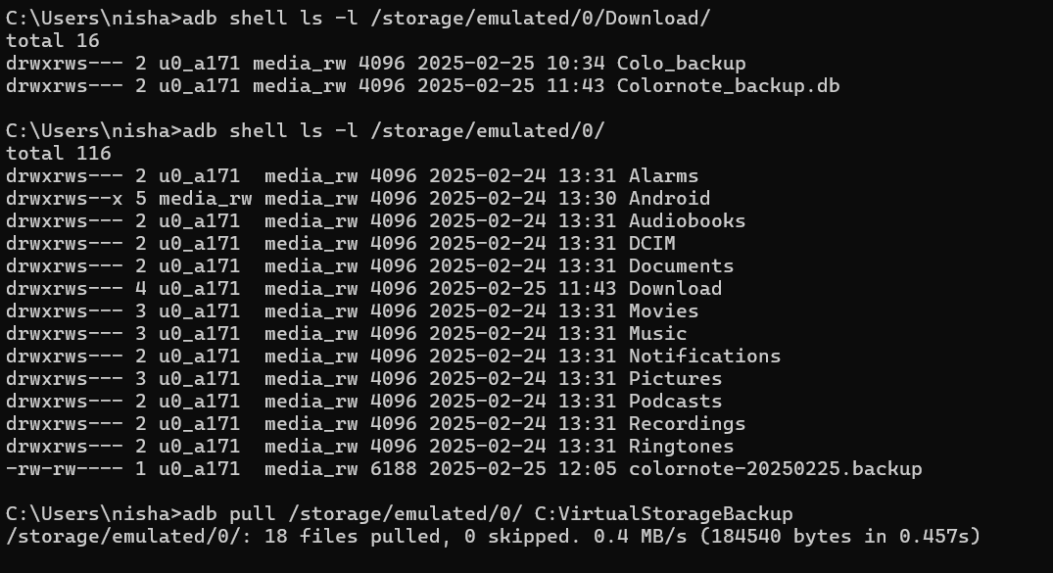

Slide 52
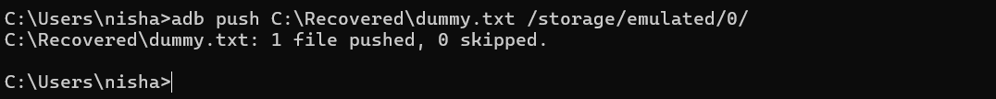

Slide 53
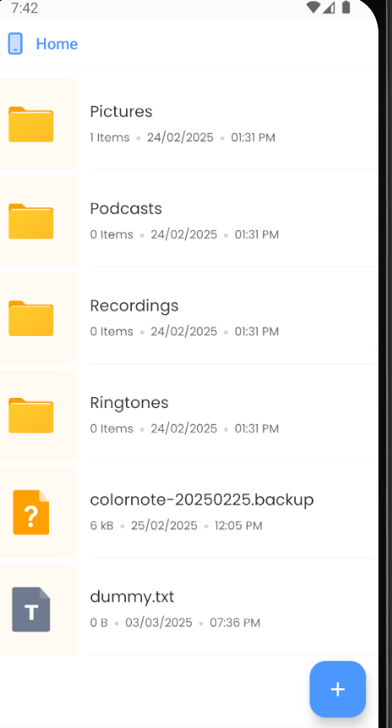
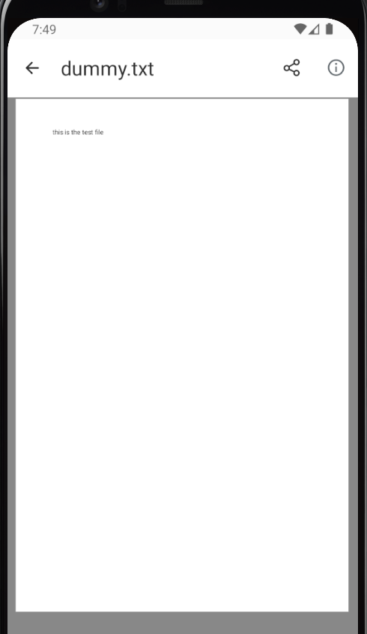

Slide 54
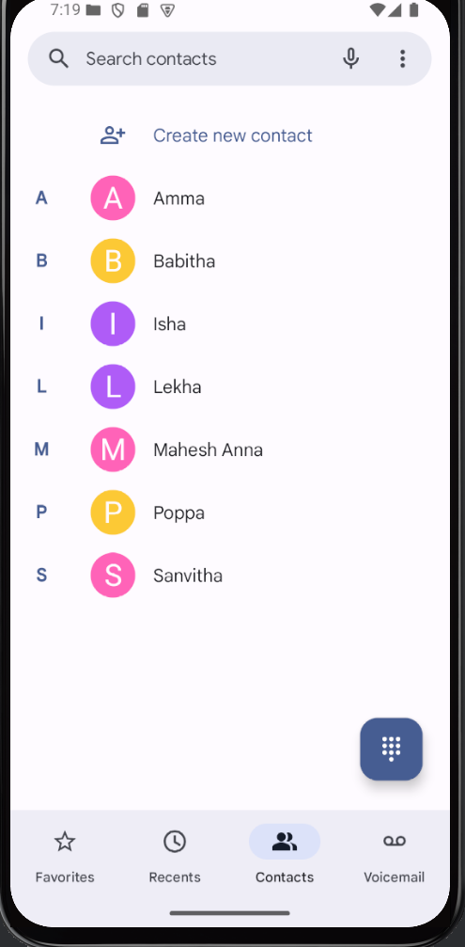
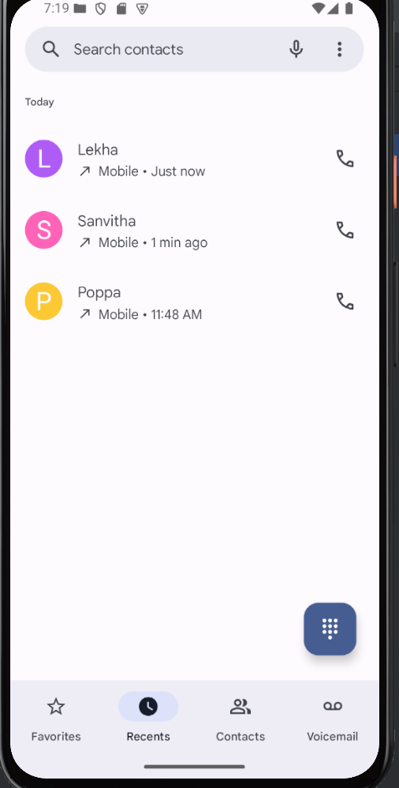
Contact list
Dialed phone list
07/03/25

Slide 55
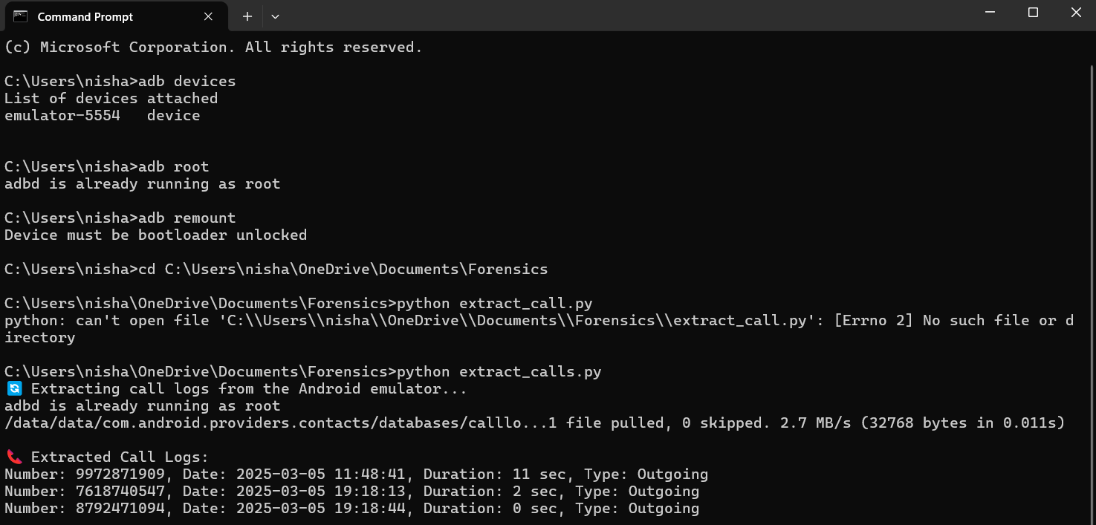
Extracting call logs

Slide 56
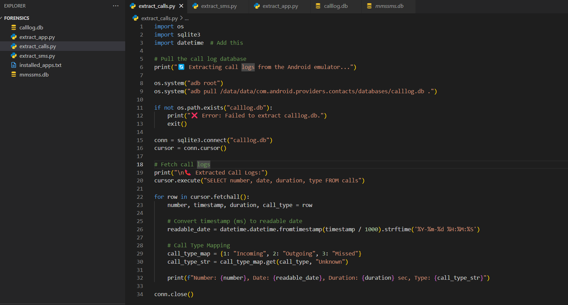
Code

Slide 57
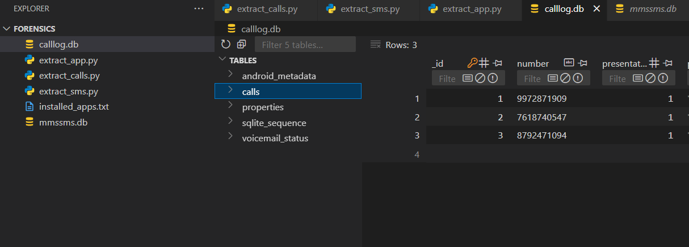

Slide 58
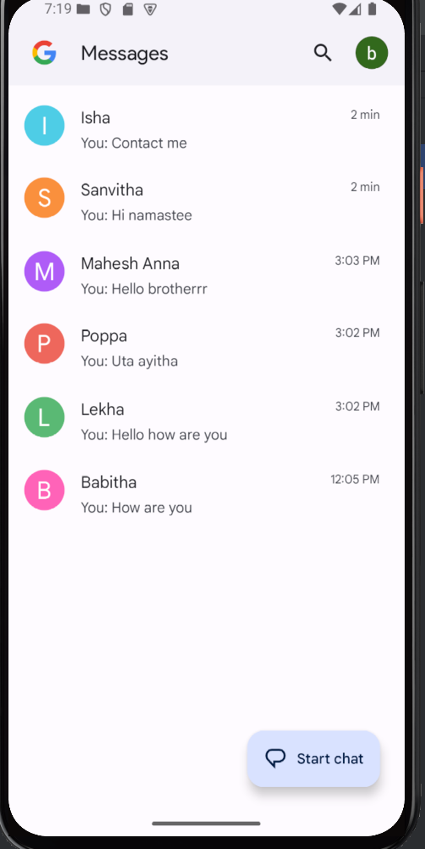
SMS list

Slide 59
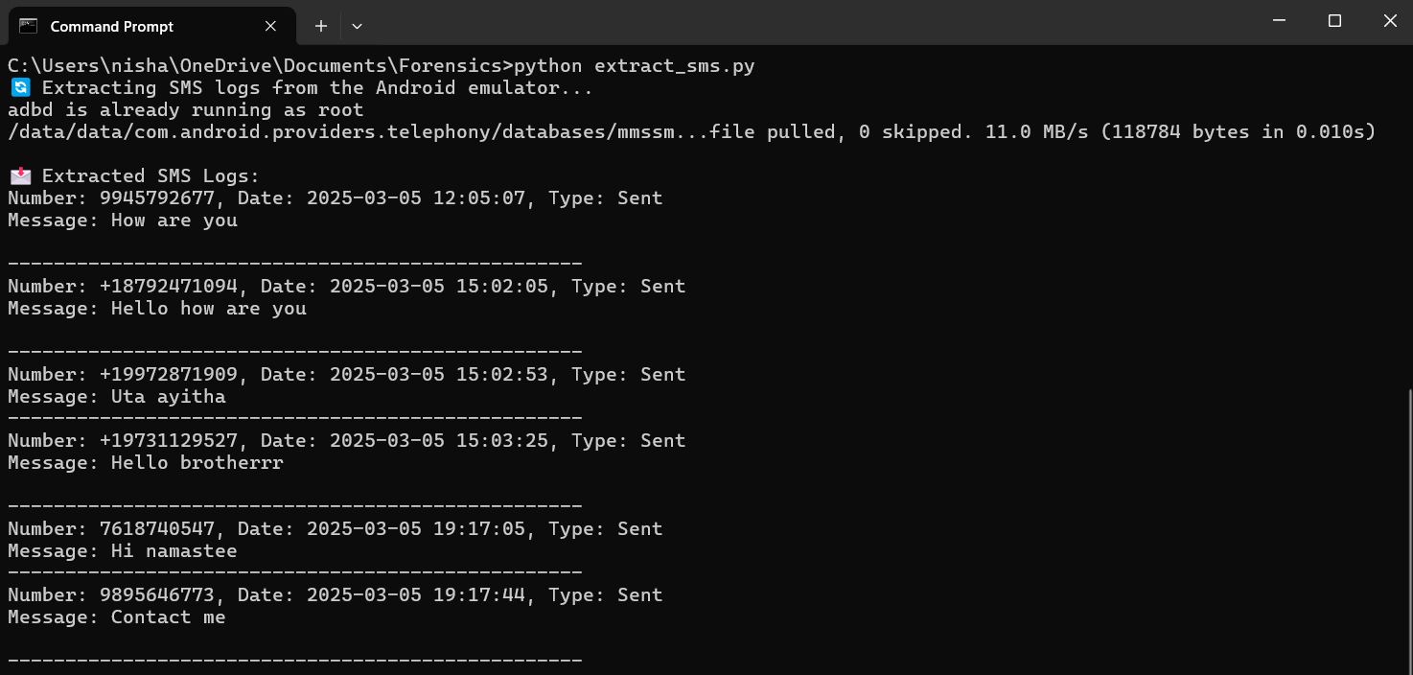
Extracting SMS list

Slide 60
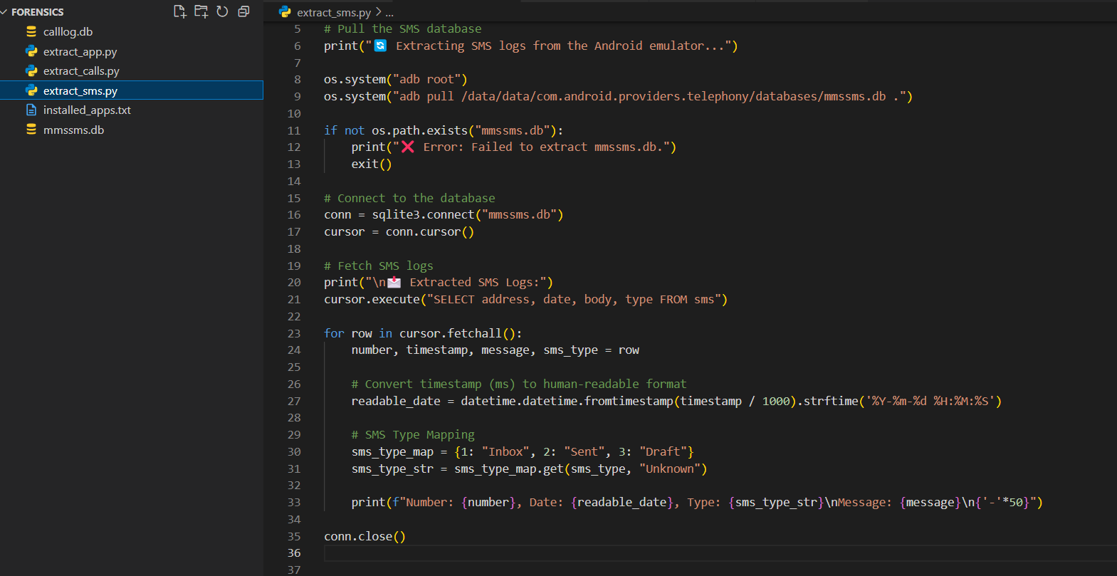

Slide 61
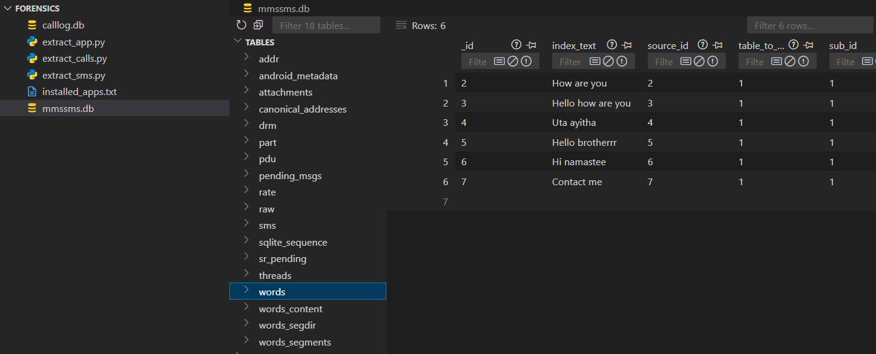

Slide 62
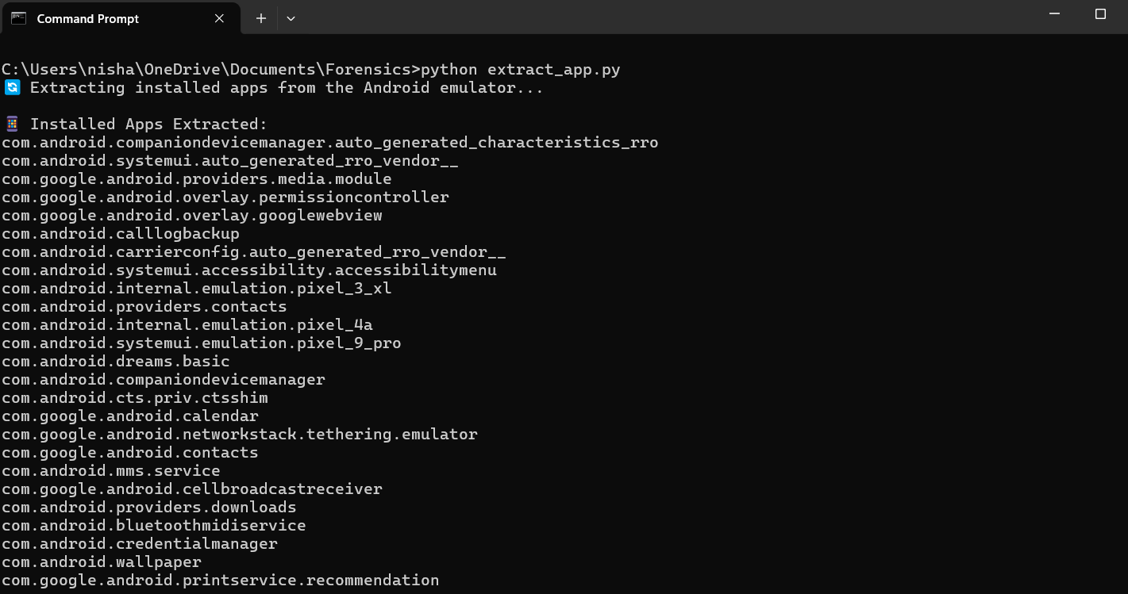
Extracting Installed apps list

Slide 63
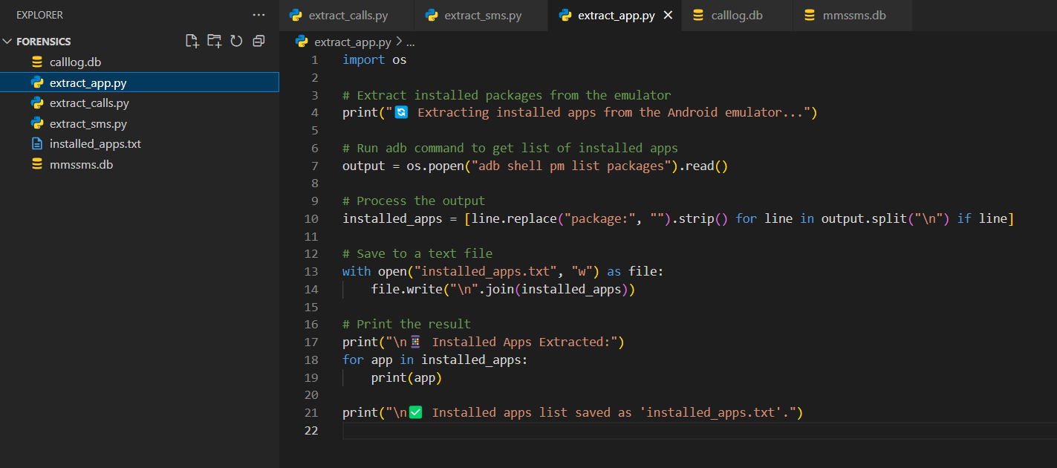

Slide 64
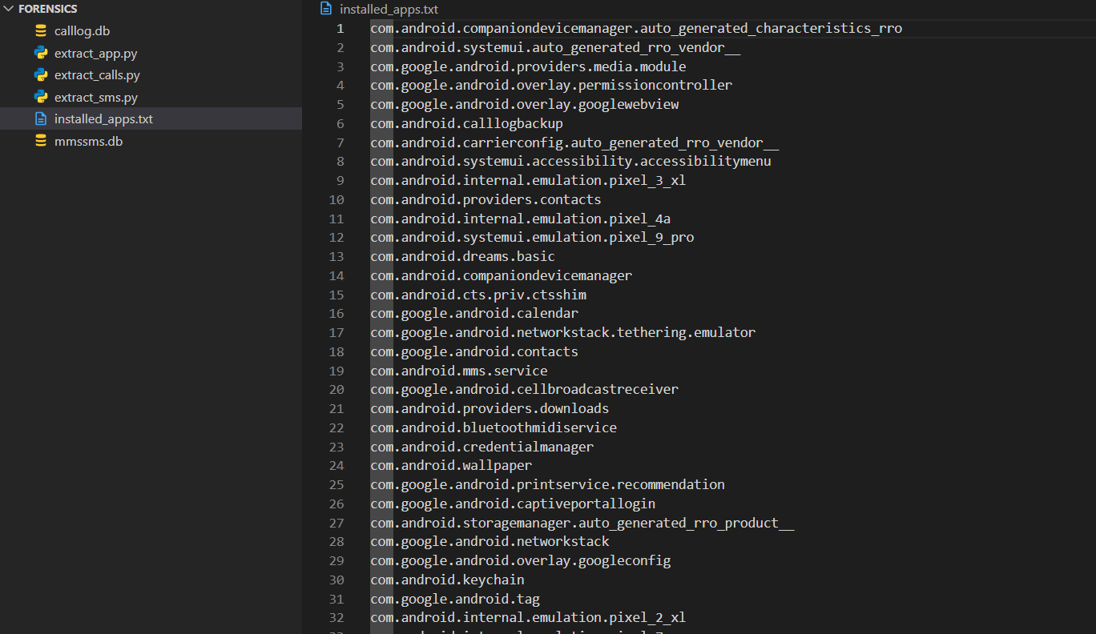

Slide 65
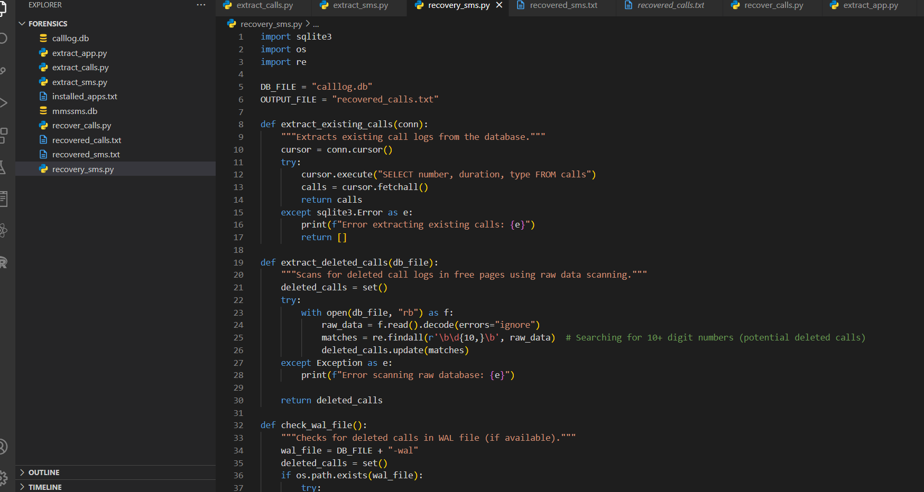
Extracting deleted sms

Slide 66
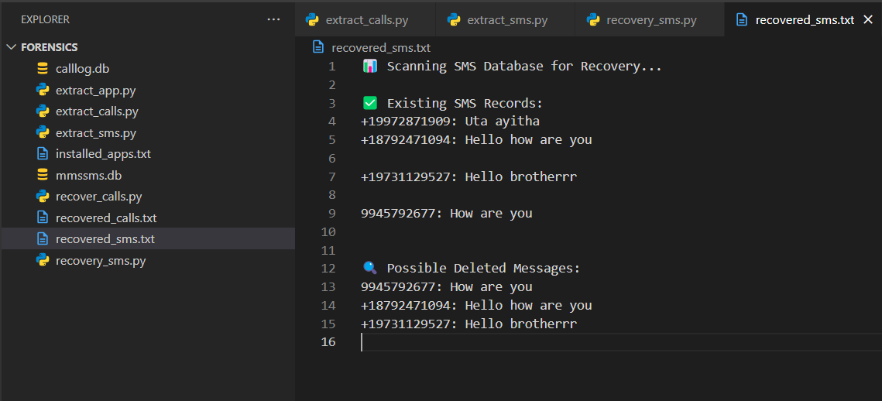

Slide 67
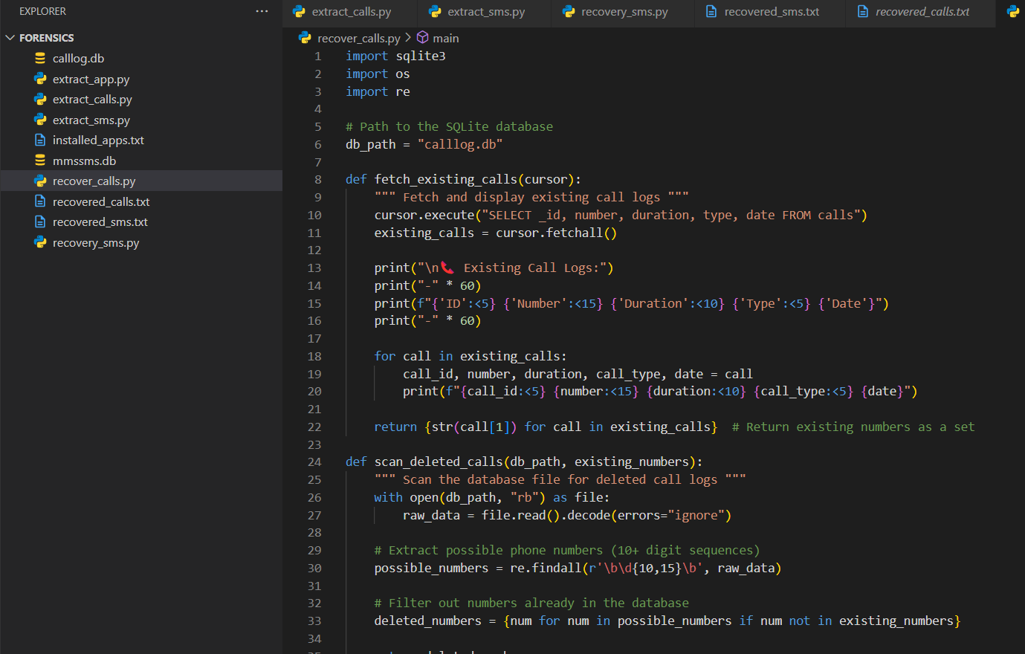
Extracting deleted call logs

Slide 68
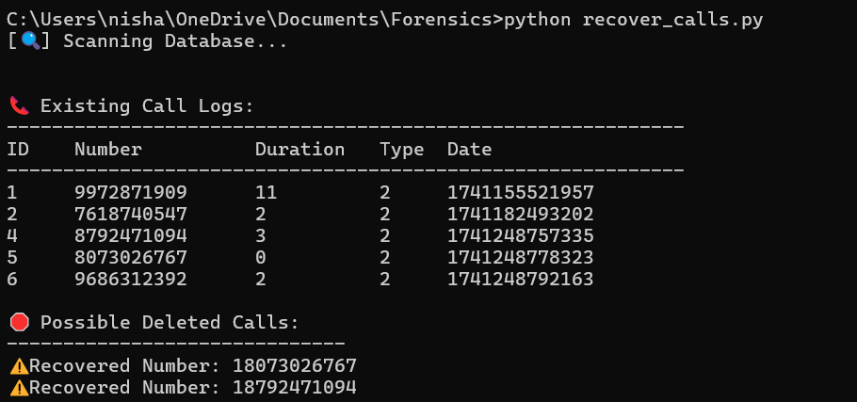

Slide 69
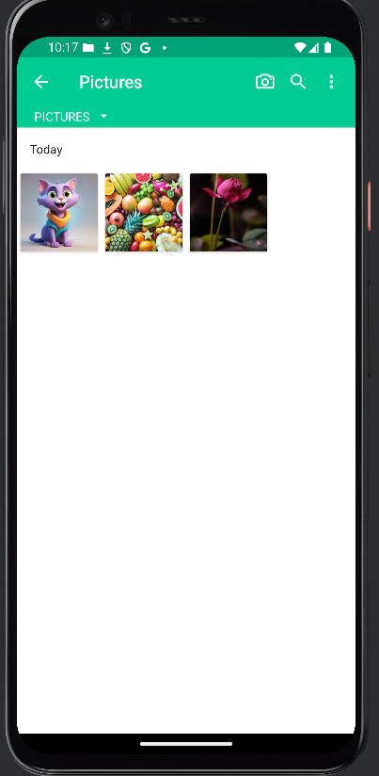
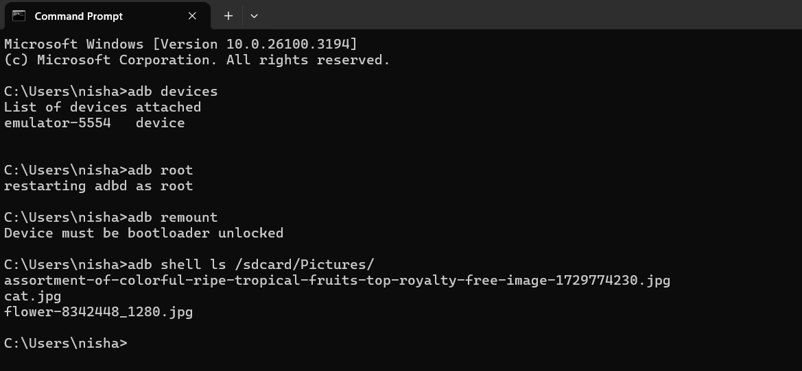
12/03/25

Slide 70
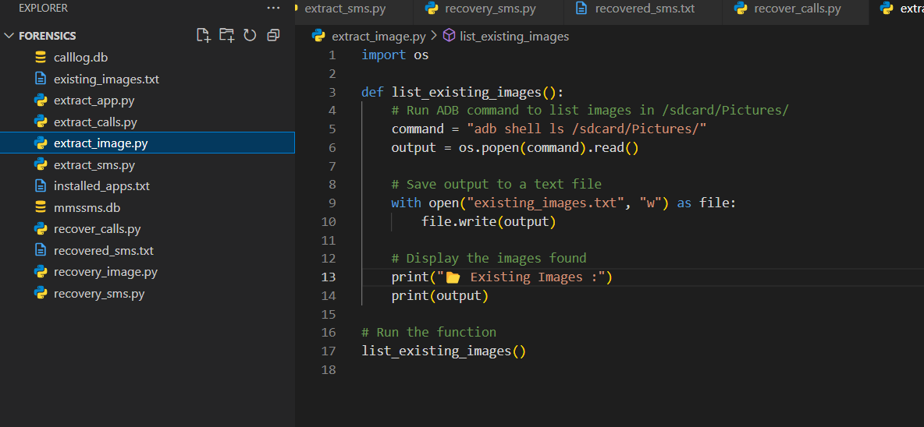

Slide 71
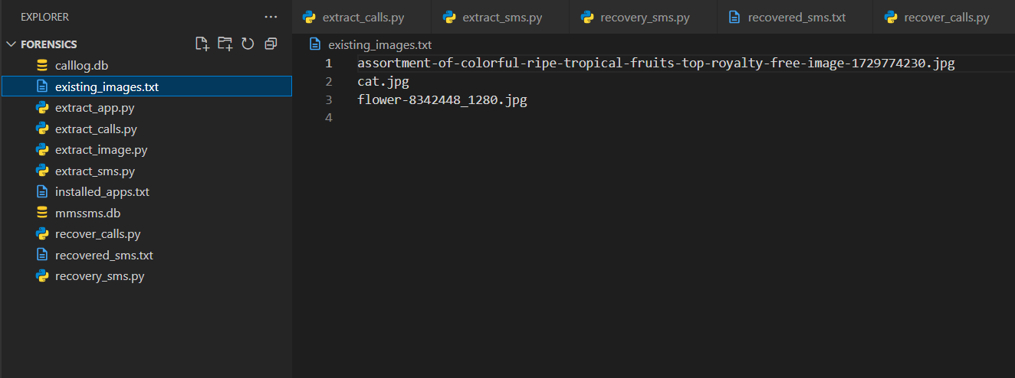

Slide 72
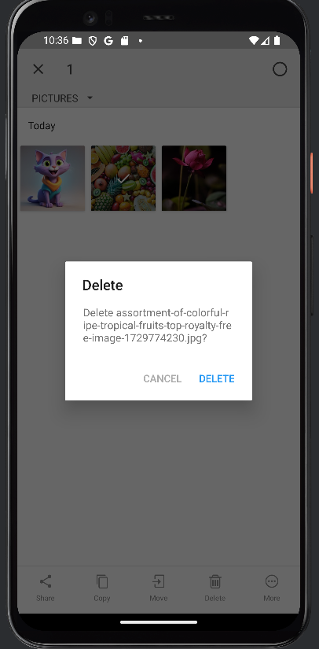

Slide 73


Slide 74


Slide 75
Summary of the Paper
The paper introduces AnForA, a tool that helps automate the forensic analysis of Android apps. Normally, investigators have to manually check apps to find evidence, which is slow and prone to mistakes. AnForA makes this process easier and faster by automatically interacting with an app, tracking the files it creates or changes, and organizing the results for analysis.
How It Works:
Install the App on a virtual Android phone.
Simulate User Actions (like sending a message or opening a file).
Monitor File Changes on the device to see what data is created or modified.
Extract & Analyze this data to understand what happened.
17/03/25

Slide 76
Why It’s Useful:
Saves time compared to manual analysis.
Works on different types of apps and devices.
Finds important digital evidence more accurately.
Test Results:
They tested AnForA on apps like Gmail, Skype, and Facebook Messenger. It found more and better-organized evidence than previous manual studies.

Slide 77


Slide 78


Slide 79


Slide 80


Slide 81


Slide 82


Slide 83


Slide 84


Slide 85


Slide 86


Slide 87


Slide 88


Slide 89


Slide 90


Slide 91


Slide 92


Slide 93


Slide 94


Slide 95


Slide 96


Slide 98


Slide 99


Slide 100


Slide 101


Slide 102


Slide 103


Slide 104


Slide 105



Slide 106


Slide 107


Slide 108


Slide 109


Slide 110



Slide 111



Slide 112


Slide 113


Slide 114


Slide 115


Slide 116


Slide 117


Slide 118


Slide 119
THANK YOU

